Slide 1

Interactive Visualization Dashboard for Domestic Flights
Lisa Hu|Zelalem Kebede | Alex Koynoff |Stephen Monteiro

Slide 2
TABLE
CONTENTS
of
01
DATASETS USED
02
METHODOLOGY OVERVIEW
Where the truth originated
Plan of action
03
WEB INTERACTION
04
KEY TAKEAWAYS
The fun part!
Let’s summarize

Slide 3
PLAN of ACTION
1
DETERMINE DATASETS
2015 historical flight data from Kaggle in CSV format
Future static data from Expedia in Json format
2
PROGRAMMING LANGUAGES USED
Clean and Manipulate data: Python Pandas Library
Web tools and libraries: HTML |CSS |Bootstrap | JavaScript (Plot.ly, D3, Node.js, Vega 5), Tableau
INITIAL PLAN
3
Create an interactive site containing aggregated flight data over several years and filter by flight volume, average price, and month of the year across days of the week
Design an interactive visualization dashboard that scrapes real-time data from Expedia that populates the site displaying top 30 routes for volume of delay and causes of delay
ACTUAL PLAN
4
Designed an interactive site with a table that allows users to search predetermined routes scrapped from Expedia for flight price, airline, and departure/arrival times
A plot.ly bar graph displaying the delay in minutes by day of the week for the top 30 routes by volume from 2015
Interactive map illustrating the routes from origin airport to all potential destinations
Notes:
cleaning the data took a long time! cleaning the data and setting up the html

Slide 4

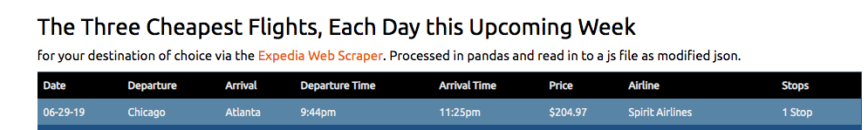

Slide 5

THE NEXT TIME YOU WANT AIRFARE DETAILS, YOU KNOW WHERE TO NAVIGATE TO
FULL VERSION TAKING OFF SOON

Slide 6
FORMATTING AND CLEANING DATA CAN BE EXTREMELY TRICKY
TIME IS ESSENTIAL SO SETTING ASIDE ENOUGH TIME TO ACCOUNT FOR OBSTACLES IS KEY
BE NIMBLE AND HAVE MANY PLANS. WHEN PLAN A FAILS, MOVE ON TO PLAN B
TAKEAWAYS

